Slide 1

INSTRUCTION GUIDE
Dear Mo Legend,
April is Testicular Cancer Awareness Month (TCAM).
It’s an important Mo-ment to raise awareness around the #1 most commonly diagnosed cancer in young men and to make sure guys know the importance of checking their nuts regularly, along with how to do it.
We couldn’t change the face of men’s health without you.
Thanks for leading the hairy charge!
HOW CAN YOU HELP?
We've put together these slides (and speaking notes) to help you spread the word.
​
Ask your boss to speak for
5 minutes before your next team meeting or company get together.
Inside you’ll find:
Testicular cancer facts and stats
A guide on how to perform a self-check​
Suggested speaking notes for each slide in the notes section
FOR PRESENTERS
(DELETE AFTER READING)

Slide 2

TESTICULAR CANCER
AWARENESS MONTH
KNOW THY NUTS THIS APRIL
Notes:
Well folks, it’s that time of year… April is Testicular Cancer Awareness Month.
Get excited!
In all seriousness, this past November we rallied as a team/company to raise some serious funds and conversations for an amazing cause: Movember and men’s health.
The folks at Movember shared this quick PowerPoint to help us continue the conversation – after all, our health matters all year round (not just for one month) and we could use a reminder on a few things.

Slide 3


What is it?
April is Testicular Cancer Awareness Month.
Know Thy Nuts is an annual campaign by Movember encouraging guys everywhere to get to know their nuts.
Notes:
This month, Movember has launched their “Know They Nuts” campaign in support of Testicular Cancer Awareness Month.
It's important because testicular cancer is the most commonly diagnosed cancer for young men.
The "Know Thy Nuts” campaign is about encouraging guys everywhere to… well… get to know their bodies and take action if something feels off.
We know some men aren’t the best at going to the doctor’s (or thinking about their health in general) so this is an important reminder. Especially since testicular cancer is the #1 cancer among young guys.
Let’s take a look at the numbers… (next slide)

Slide 4
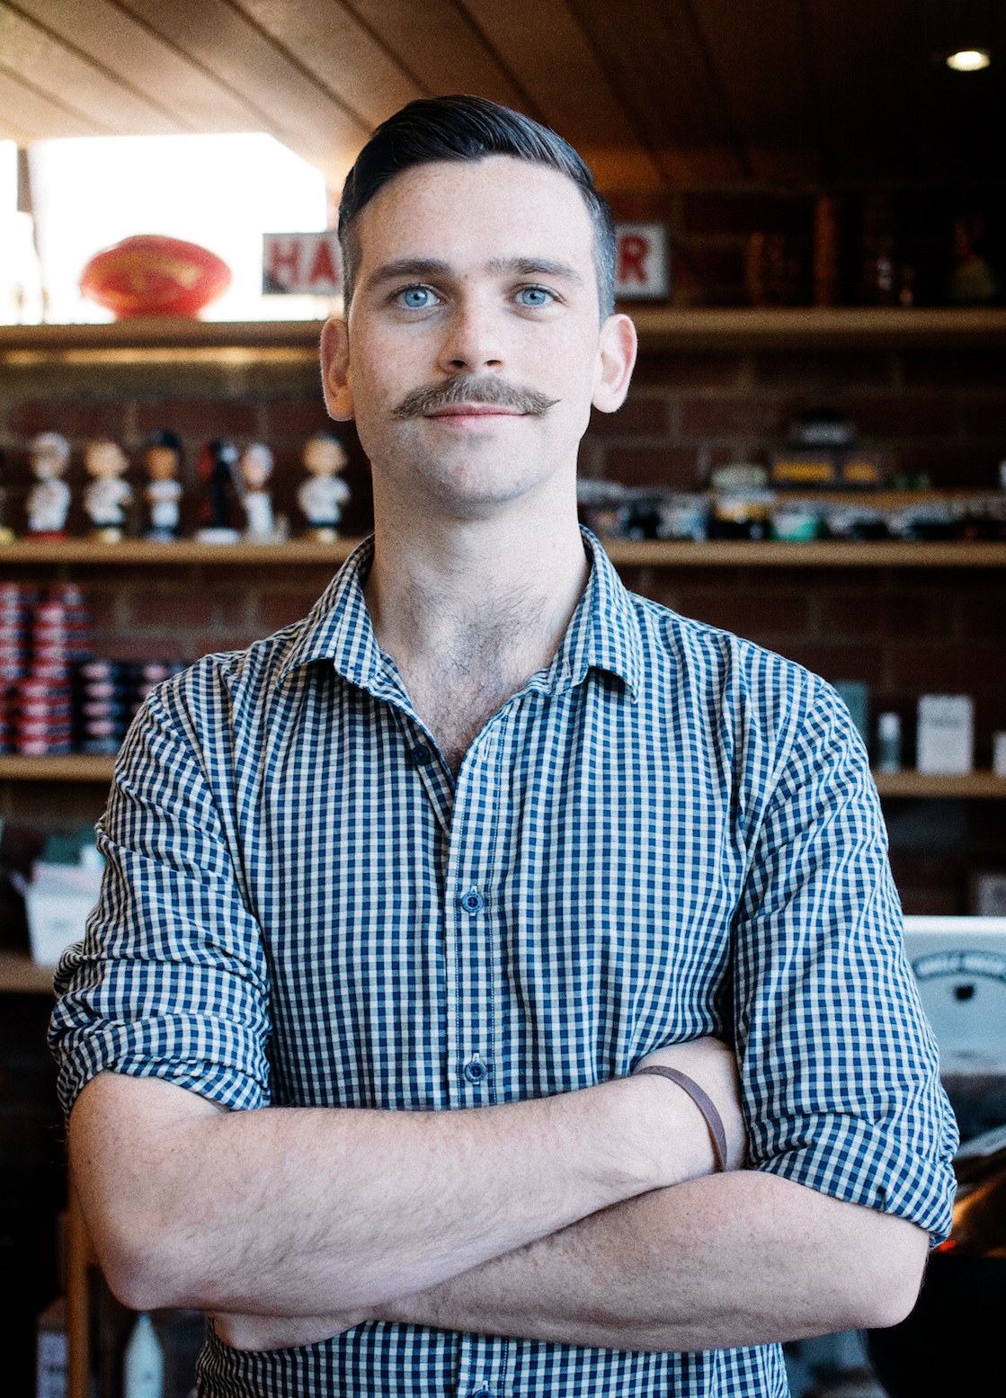

#1
91,500
Testicular cancer is the most common cancer in young men
While it’s rare (it accounts for 1%
of all male tumours), there are still
91,500 men across the world who are diagnosed each year.
95%
2 IN 5
The odds of beating testicular cancer are quite good, especially when it’s caught and treated early. The overall survival rate is around 95% and rising.
Testicular cancer by
the numbers
Only 2 in 5 young men know how to check their nuts.
HOW TO TAKE ACTION
The best thing you can do is get to know your nuts, know what's normal for you, and if there are any unusual changes or something just doesn't feel right for you, see a doctor.
Notes:
As mentioned, testicular cancer is the #1 most commonly diagnosed cancer for young men. We’re talking about guys aged around 15-40.
While it’s a rare cancer by comparison to others, 91,500 guys will face a testicular cancer diagnosis each year.
Despite this, our research suggests that 2 in 5 young men (62%) don’t know how to check their nuts.
The good news? The odds of beating testicular cancer are quite good when it’s caught and treated early – with an overall survival rate of 95%.
So, during April, Movember wants to remind all the men out there to get to “Know Thy Nuts” by giving them a feel in the shower.
Lots of guys are doing it – and you should too!
Movember put together a funny (but important) video that shows you how… (next slide)

Slide 5

Notes:
YouTube video: https://www.youtube.com/watch?v=OhojaxF7Rc0
**After video is done playing**
Behind the cheeky pears, Movember has some specific goals here:
Check your nuts. In the three simple steps we just saw, you can get familiar with your testicles.
What to look for: Once you know what feels normal for you, it’s easier to notice if anything changes over time.
Found something out of the ordinary? Get it checked by a doctor. Movember research shows that some guys put off this step because of embarrassment or worry. But when something's not right with your equipment, it's key to get it checked by a professional. Like you would if your car engine started rattling.

Slide 6
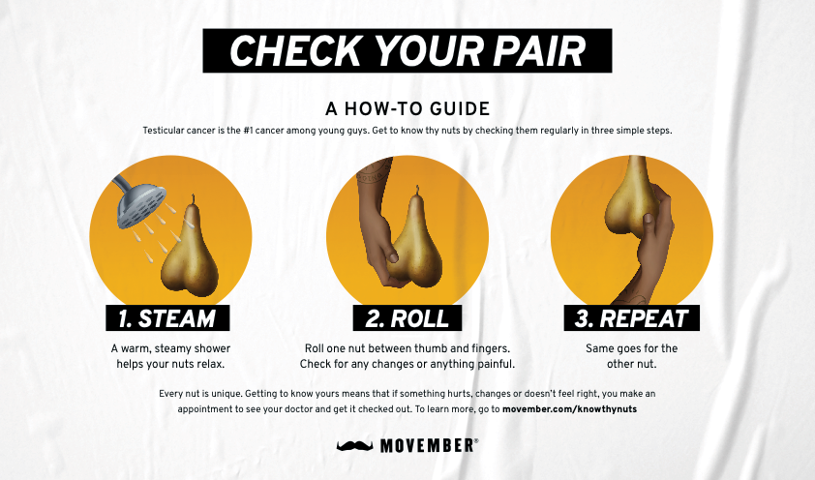
Notes:
**OPTIONAL**
If you don’t want to show the video – you can use this simple slide and run through the steps yourself. (Note: the play on words, “check your pair” and using a pear. Quite clever, right?)
Here are the 3 simple steps:
1) Find a private place to do the self-check. Movember recommends the shower as a great spot.
2) Then simply roll your testicle between your thumb and your index finger. It should feel round and smooth. Get to know what feels regular.
3) *Don’t choose favourites* make sure you repeat with the second testicle .
Get to know what feels regular. And if one day anything feels different (a lump, pain, the size, etc.) – take action and get it check out.

Slide 7

“We usually get so distracted with how busy our day-to-day lives are that we neglect to take care of ourselves and to make time for it.
If we can help people become more comfortable talking about their health and being more open, we can catch it early and save lives.”
Ray Clinger
Testicular Cancer Survivor
Notes:
As the video mentioned, if something doesn’t feel right, head to the doctors.
Ray Clinger, a testicular cancer survivor, said this: read quote
So, let’s all make sure we are checking, and telling our friends (brothers, partners, colleagues, etc.) to do the same.

Slide 8




HOW WILL YOU TAKE ACTION?
Check your pair using Movember’s how-to guide
Make it a regular habit. And if something doesn’t feel right, get it checked by a doctor.
Share what you learned today with a man in your life
Learn more about testicular cancer at movember.com/KnowThyNuts
Notes:
Ok, we’re coming to the end of the slides now.
As we go through the month of April, here are 4 ways that you can take action:

Slide 9

THANK YOU
Learn more at movember.com/KnowThyNuts
Notes:
Finally, I’ll wrap up by saying, while Movember is renowned for spotlighting men's health in November, I hope this presentation serves as a powerful reminder that our health deserves attention and care every single day of the year.
Thank you everyone for your attention!

